Slide 1
The Franck-Hertz Experiment
Kitty Harris and Josh Elsarboukh

Slide 2
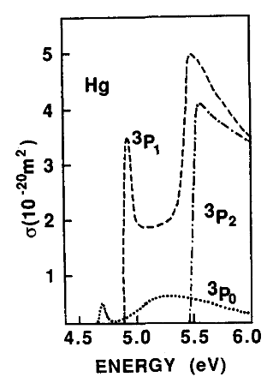
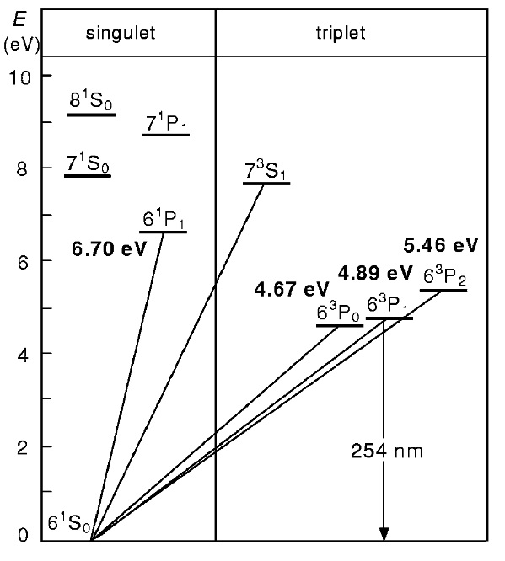


Electron Energy and scattering Cross-Section
The Franck-Hertz experiment, presented in 1914 by James Franck and Gustav Hertz, involves accelerating electrons through mercury (also done with neon) vapor via a potential grid, towards a beam current collecting anode. As the accelerated electrons gain sufficient energy for excitation, the cross-section of inelastic collisions increases. This can be seen in the diagram to the left, which shows roughly the cross section of inelastic electron-mercury collisions as a function of electron energy. The points of highest cross-section correspond approximately to the three lowest energy states at 4.67, 4.89, and 5.46 volts, respectively.
The cross-section can best be understood as an effective 'area' inside of which a scattering event can occur. It is not only related to accelerating electron energy, but also the mean free path of the electrons, as well as temperature.
Cross-section of inelastic collisions vs. electron energy. Uncertainty of 30% due to measurement imprecisions.
Haken & Wolf, p 698
Lowest energy states of mercury. Haken & Wolf, p 697
$$σ=\frac{k_{B}T}{Pλ}$$
(Where P is the pressure, which is a function of the temperature T, and $λ$ is the mean free path, which is dependent on electron energy.)

Slide 3
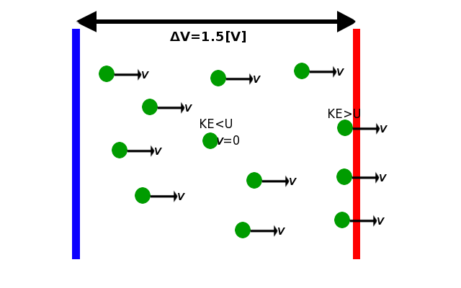

Current minima at Energy Intervals
To reach the collection plate, electrons must overcome a potential difference.
Only electrons with sufficient energy can overcome this difference:
$$\frac{m_{e}}{2}v^{2}=KE≥U=qΔV$$
So electrons which have lost too much energy in collisions can’t make it across the 1.5[V] potential.
Current reflects this: $I=neAv$ increases as the number of electrons (that reach the collection plate, where the current is being read) increases.
We see a smooth curve because velocity (and therefore energy) is a probabilistic distribution, not the same for each electron, and because not all electrons will collide.

Slide 4

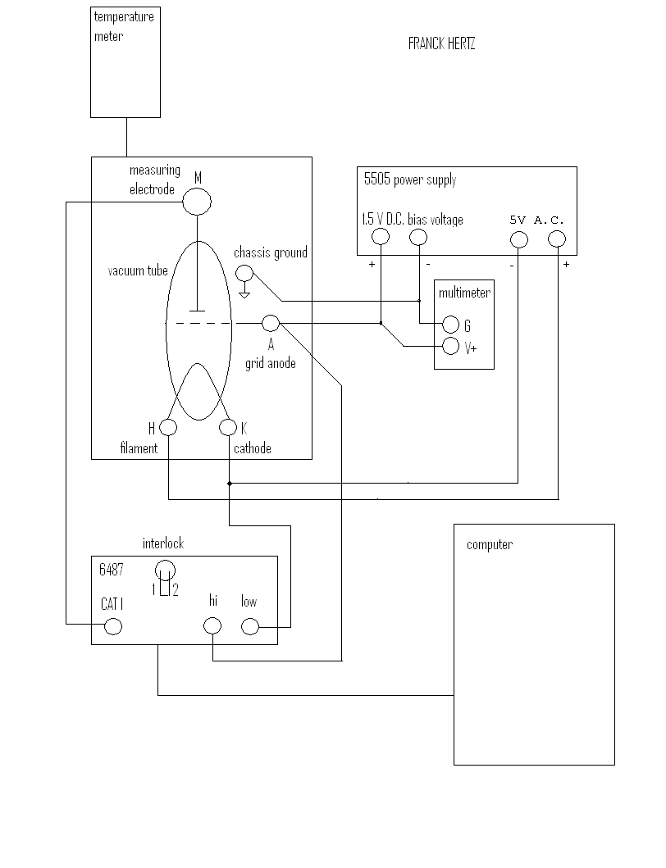
Setup
We will be focusing on the Keithley 6487 and the portion inside the quartz tube.
Diagrams uploaded by Dr. Tagg to https://sites.google.com/site/experimentalphysicsdecathlon/home/04-fundamental-quantum-behavior/franck-hertz-experiment. Diagram to the right is titled “FRANCK HERTZ.bmp”.
Diagram in the next slide is pulled from the safety instructions in “device.pdf”.

Slide 5
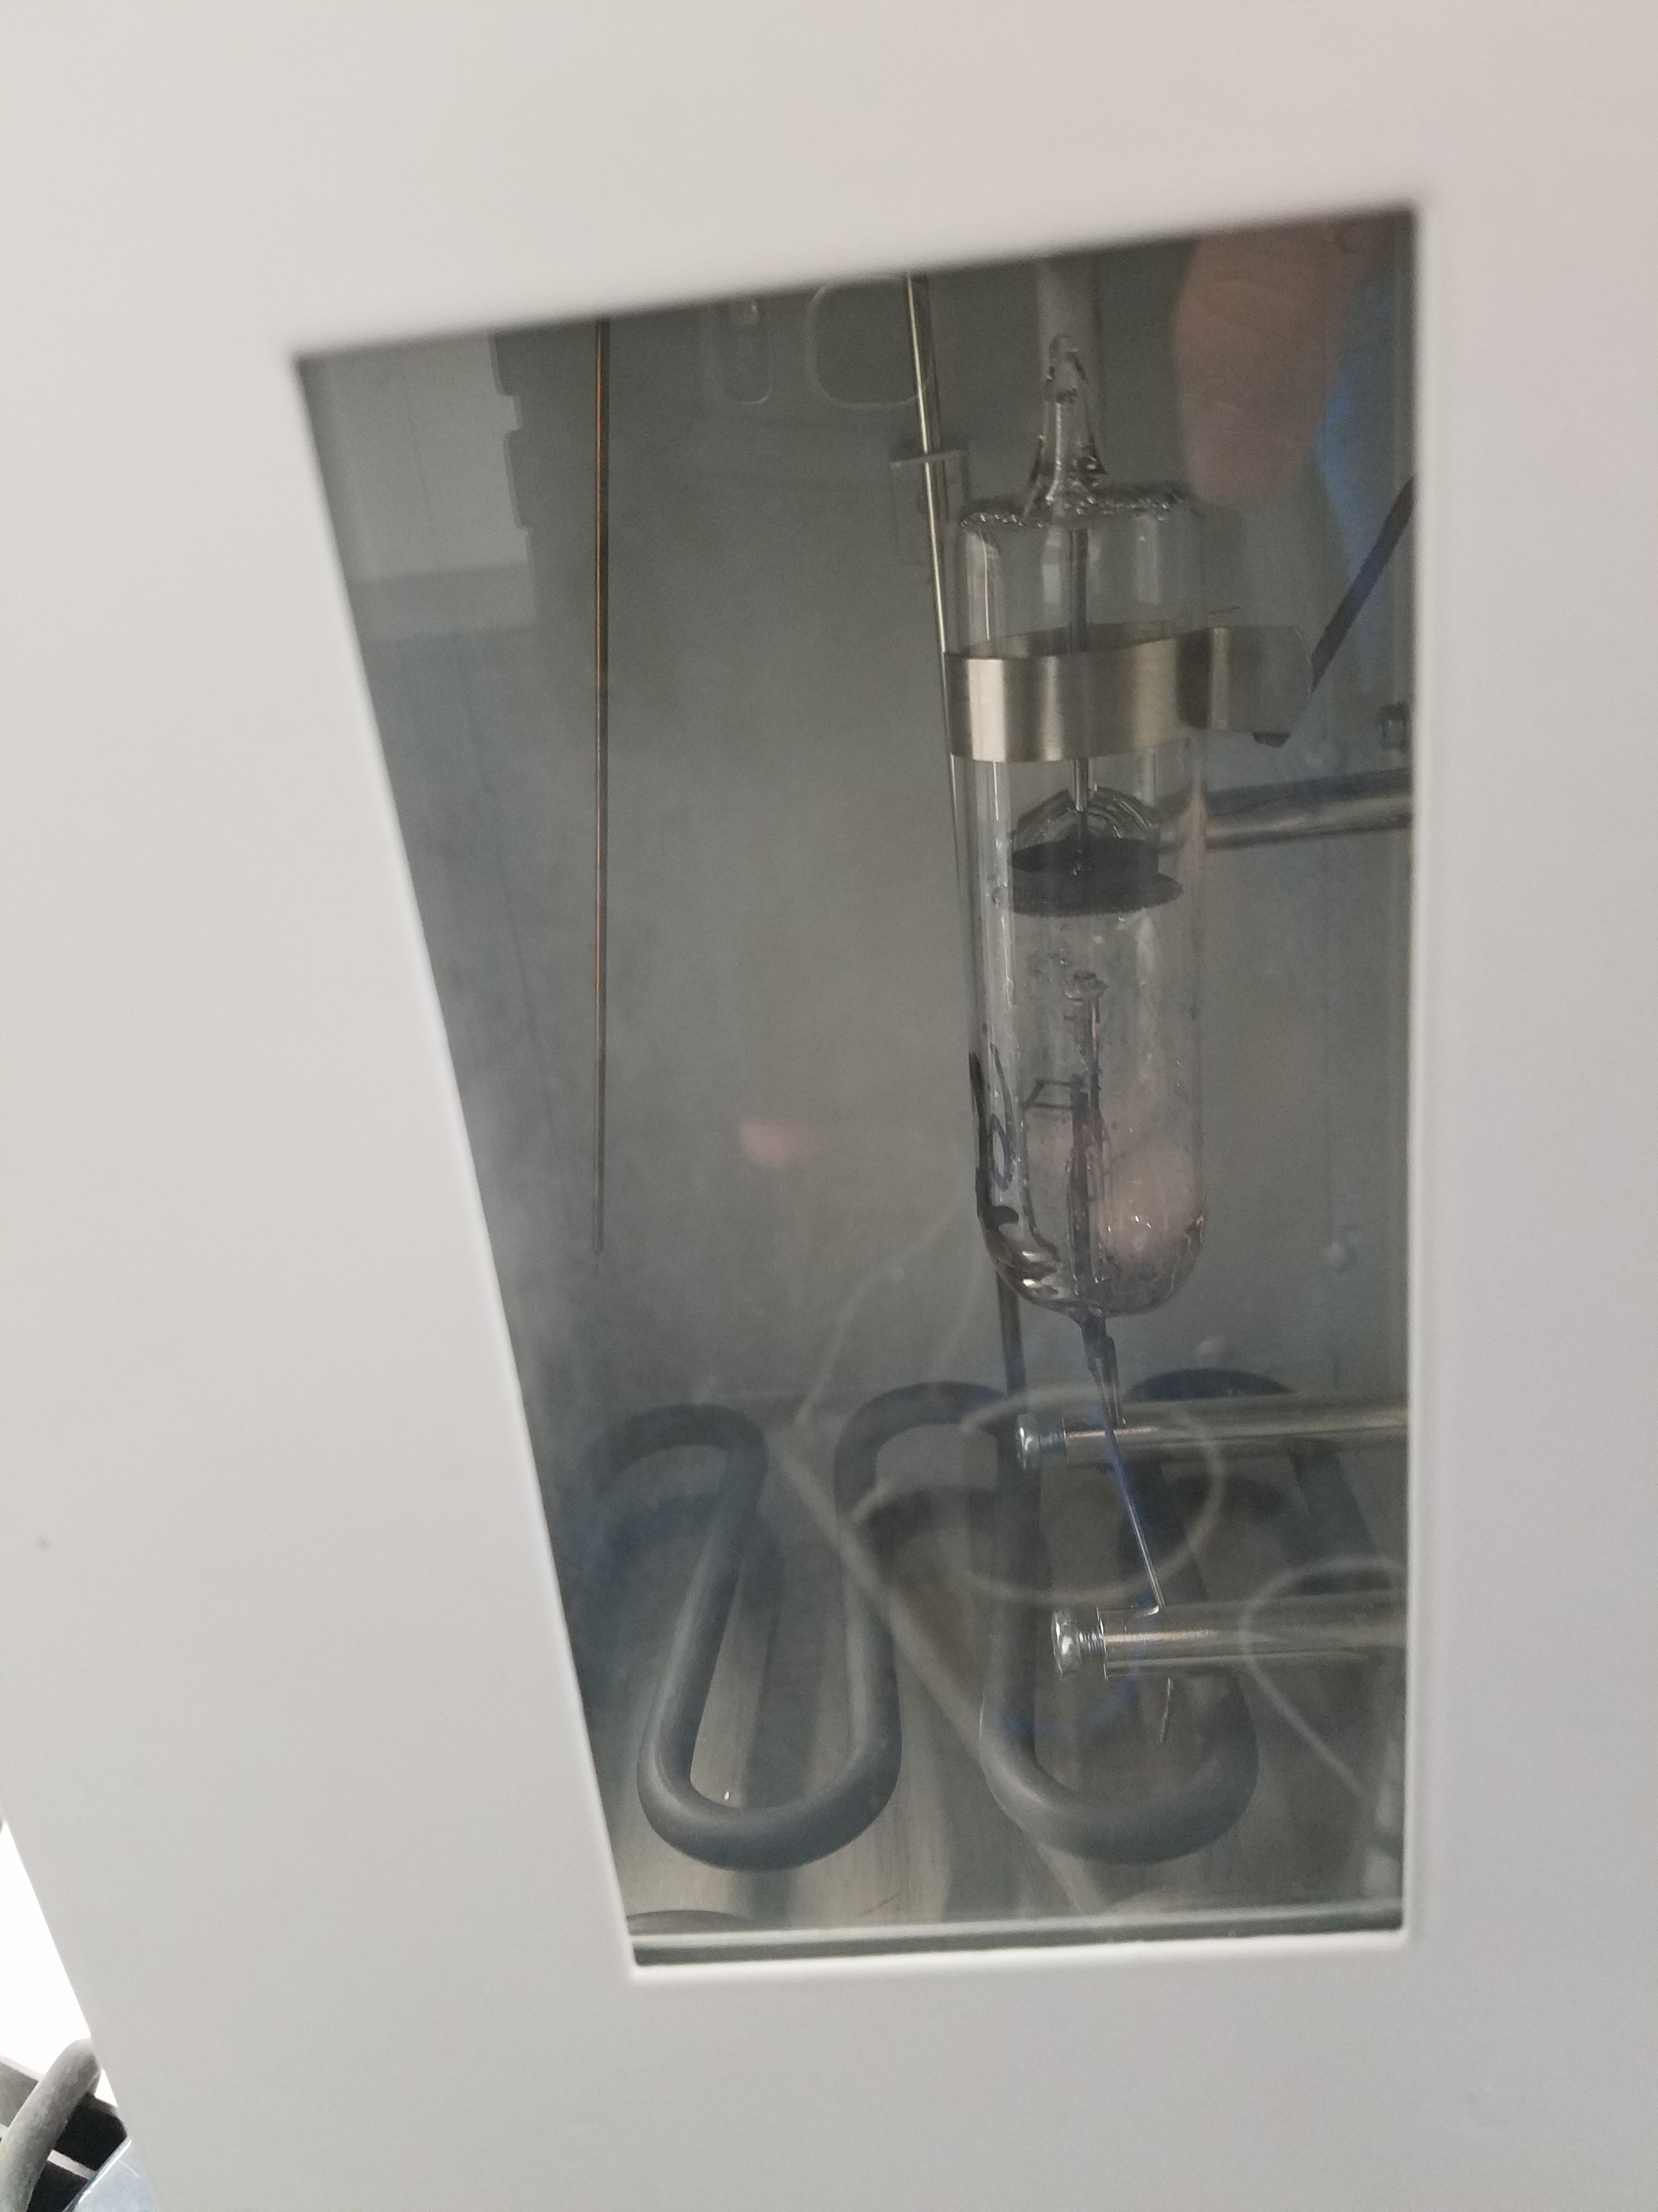
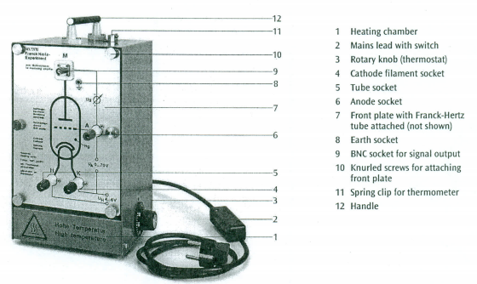
Inside the Quartz Tube
Quartz Tube
Electromagnetically Non-Conductive
Transparent
Common: Makes it relatively cheap compared to alternatives
Average thermal conductivity prevents it from having a major contribution to temperature.
Vacuum prevents vapor from escaping, prevents other gases from entering, and keeps pressure low.
Mercury Vapor
Boiling Point: 629.88[K] – much greater than the box.
However, pressure is very low (O~10⁻³[atm]), so vapor is easy to maintain.
Excited states are distinct.
Tungsten Fillament (Cathode)
Electrons are boiled off – high resistance > excess heat > high electron energy
Grid (Anode)
This is where we sweep potential relative to the cathode.
Collection Plate
Swept to stay at a 1.5[V] difference from the anode, reducing KE of incoming electrons.
This is where current is measured.

Slide 6

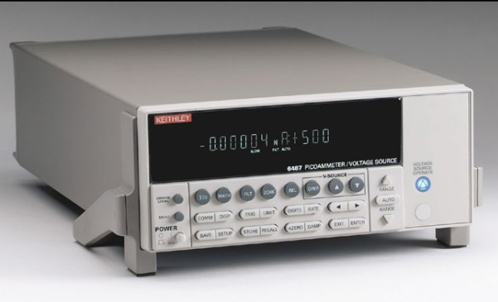
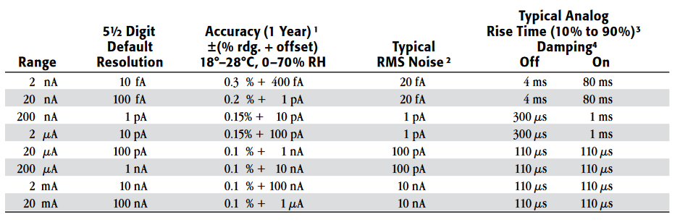
Keithley 6487
Dual picoammeter and variable voltage source
Ideal for low-, dark-, and beam-current measurements
Fine resolution, low noise
I/O trigger modes for automated production
Ammeter Resolution: 10[fA]
Sweeping Voltage:
200 microvolts to 500 volts
200 steps per second
0.2 millivolt resolution
Burden Voltage: <200 microvolts

Slide 7
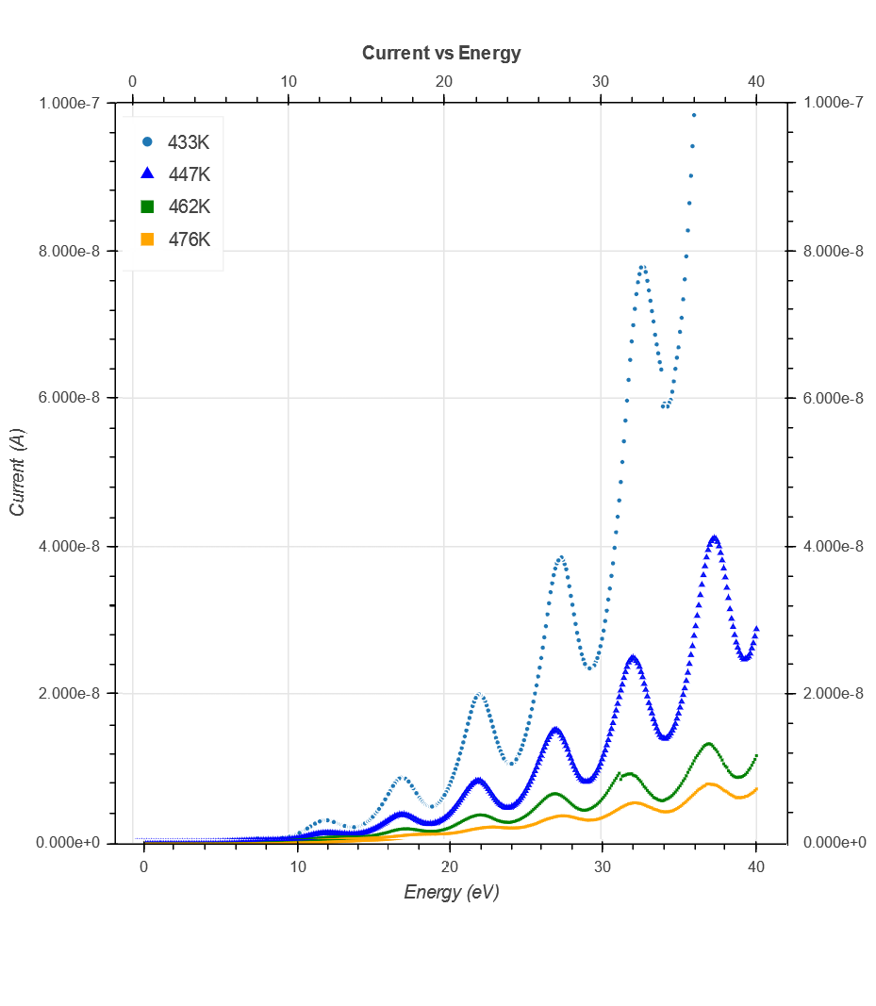

Temperature-Dependence of ΔE
Temperature [K] | 433 | 447 | 462 | 476
Energy (E_{a}) [eV] | 4.85 | 5.03 | 4.99 | 4.91
Uncertainties are ±0.1[eV]
Since our carriers are electrons, voltage [V] and energy [eV] measurements are identical.
Minima were determined by taking curve fits to slices of data.
Then the distances between these minima were plotted.
$$ΔE=\left\lfloor 1+\frac{λ}{L}\left(2n−1\right)\right\rfloor E_{a}$$
$$σ=\frac{k_{B}T}{pλ}$$
$$E_{a}=ΔE_{(n=\frac{1}{2})}$$

Slide 8
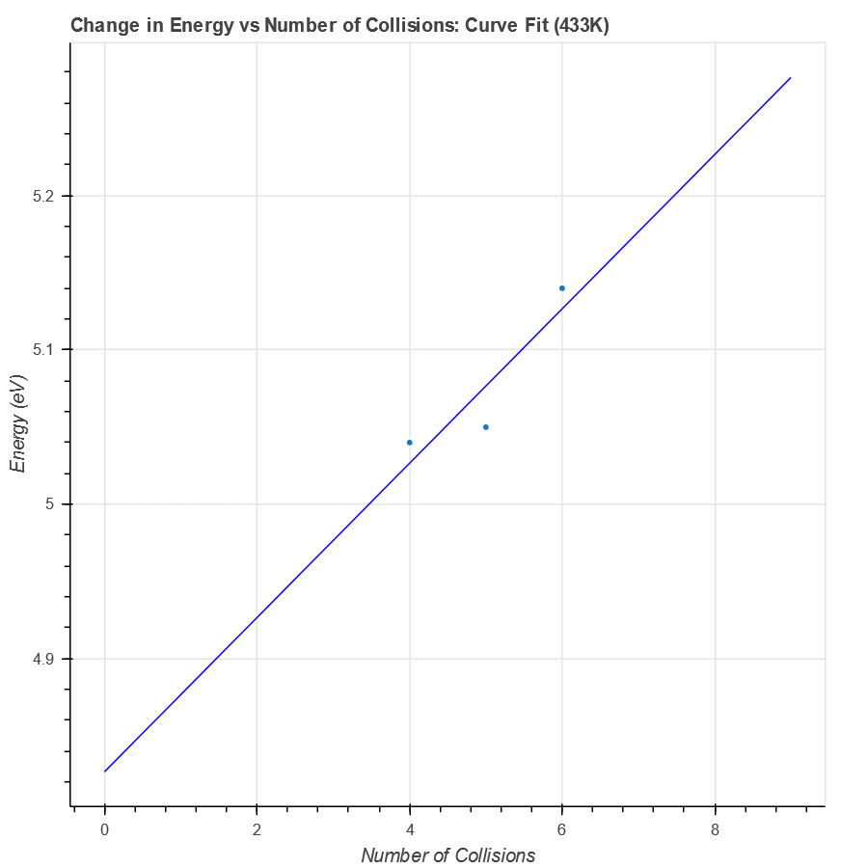
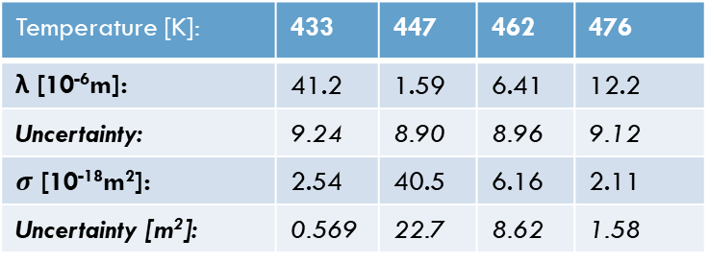

Finding the Cross-Section for Collisions
Cross-section is sensitive to movement of particles, therefore varying with temperature:
$$σ=\frac{k_{B}T}{8.7∗{10}^{9−\frac{3110\left[K\right]}{T}}\left[Pa\right]λ}$$
The mean free path is taken from the slope of the function: $\frac{dΔE}{dn}=\frac{2λ}{L}E_{a}$
Temperature [K]: | 433 | 447 | 462 | 476
λ [10⁻⁶m]: | 41.2 | 1.59 | 6.41 | 12.2
Uncertainty: | 9.24 | 8.90 | 8.96 | 9.12
$σ$ [10⁻¹⁸m²]: | 2.54 | 40.5 | 6.16 | 2.11
Uncertainty [m²]: | 0.569 | 22.7 | 8.62 | 1.58

Slide 9
Works Cited
Abdulagatov, I. M., et al. “Thermal Conductivity of Fused Quartz and Quartz Ceramic at High Temperatures and High Pressures.” ScienceDirect, Academic Press, May 2000, www.sciencedirect.com/science/article/pii/S0022369799002681.
“Alpha: Making the World's Knowledge Computable.” Wolfram, 2019, www.wolframalpha.com/.
Friedman, Hershel. “Minerals.net.” Ice: The Mineral Ice Information and Pictures, 2019, www.minerals.net/mineral/quartz.aspx.
Hackman. “Information on Electronic Quartz Crystals.” Hackman's Realm, lateblt.tripod.com/xtals.htm.
Hann, G.F. "What Really Happens in the Franck-Hertz Experiment with Mercury?" American Journal of Physics 56, 696 (1988). http://home.uni-leipzig.de/~physik/sites/mona/wp-content/uploads/sites/3/2017/08/Franck-Hertz-Experiment.pdf.
“What Is Important About Thermal Properties?” Amethyst Galleries Mineral Gallery, 2014, www.galleries.com/minerals/property/thermal.htm.
“5: Thermionic Emission.” http://www.physics.csbsju.edu/370/thermionic.pdf.

